Slide 1

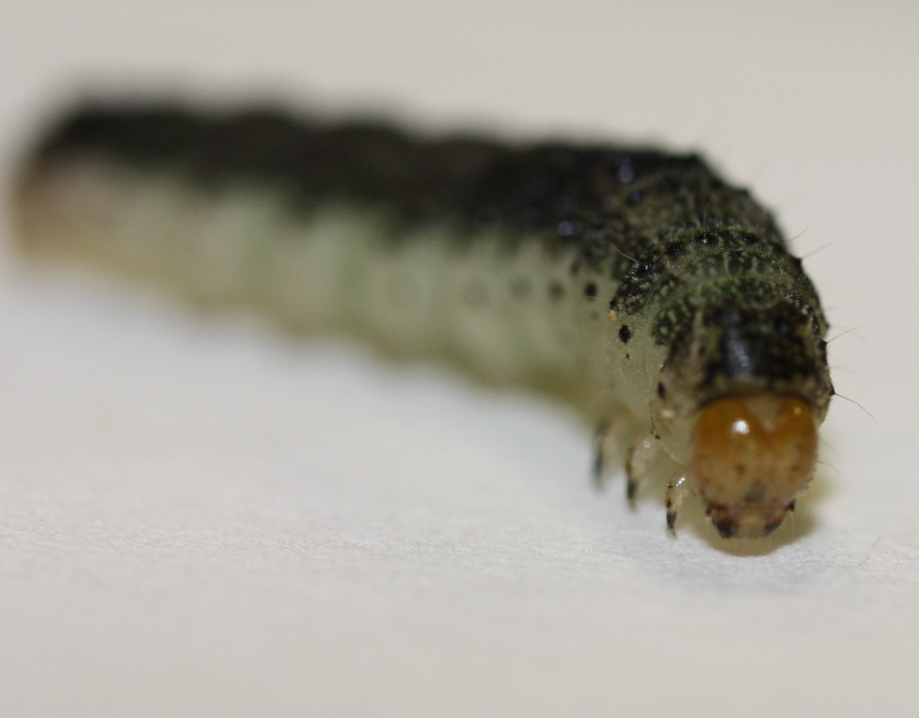

How a jack of all trades can be a master of many: The transcriptomic basis of host plant use by a generalist pest, Chloridea virescens (Lepidoptera: Noctuidae)
Kelsey Payne, CUNY-LaGuardia Community College
Mentors: Dr. Sara Oppenheim, Dr. Robert DeSalle
Biology NSF-REU, American Museum of Natural History, Summer 2015

Slide 2
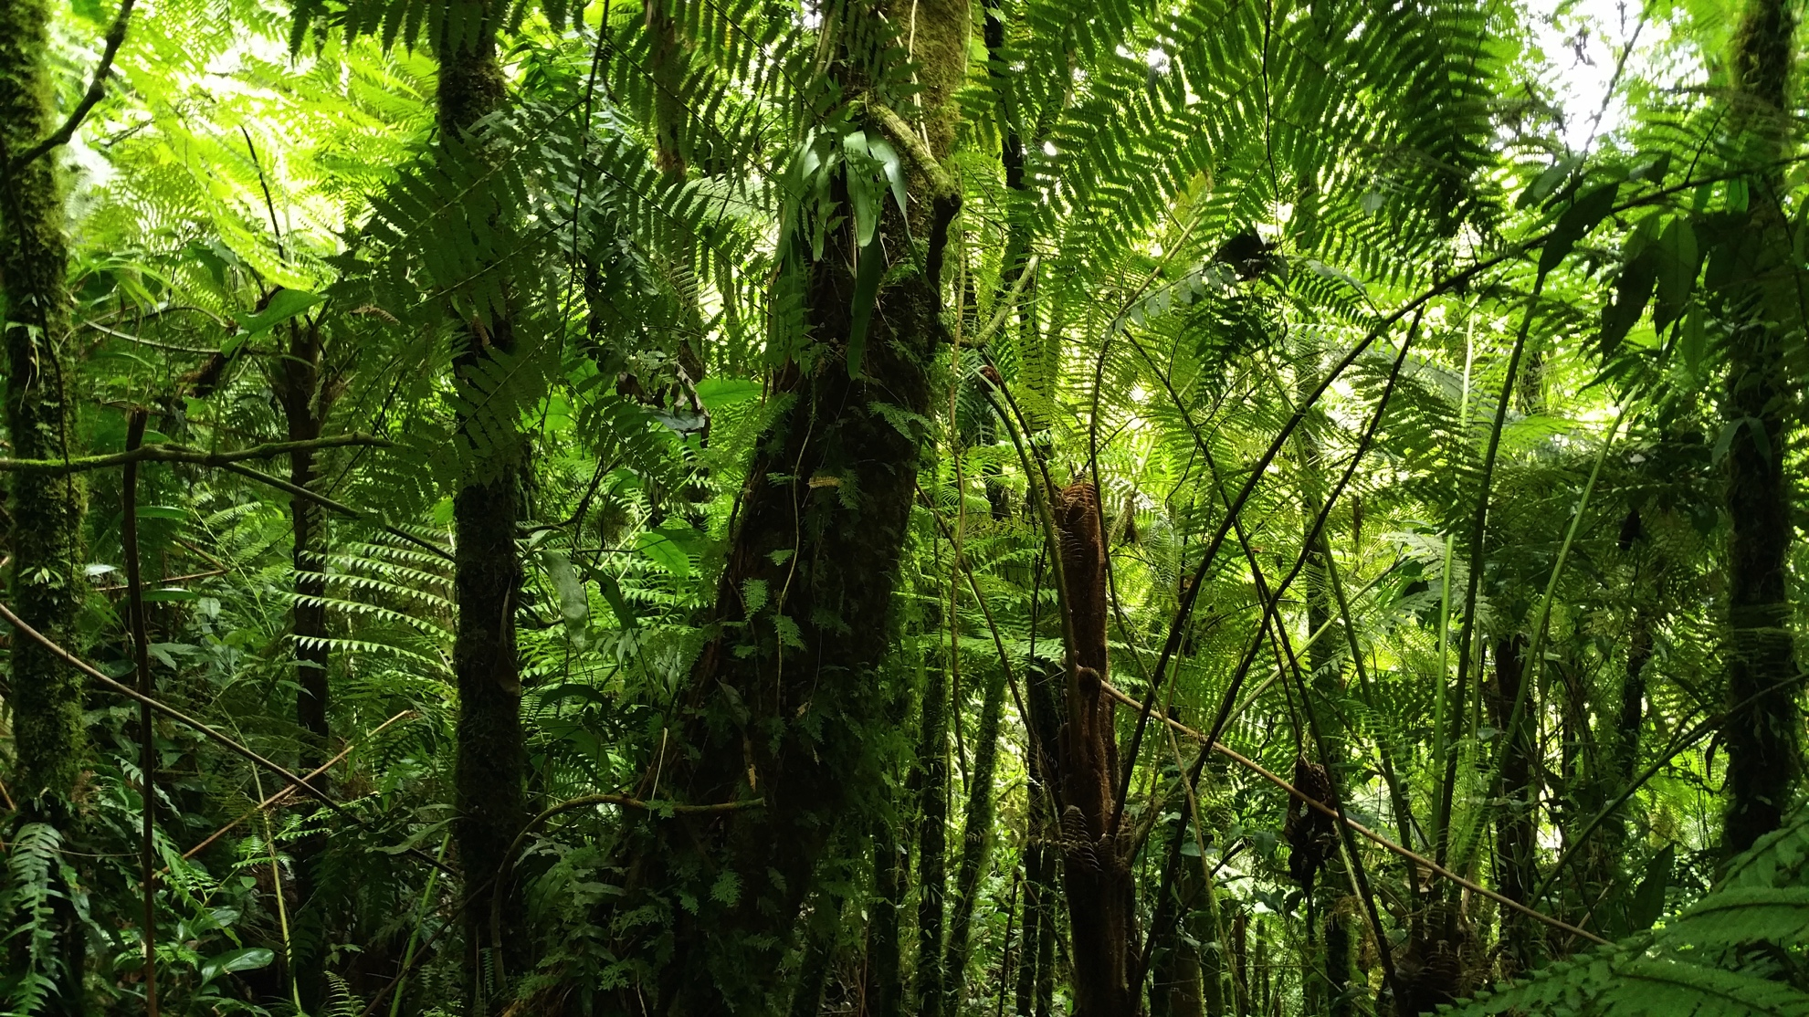
Insects and their host plants

Slide 3
Host plant range in the Heliothinae
H. armigera
H. zea
H. assulta
H. punctigera
H. gelotopoeon
C. molochitina
C. planaltina
C. beckeri
C. ebenicor
C. parana
C. tergemina
C. subflexa
C. puno
C. citrea
C. distincta
C. mirabilis
C. virescens
C. enigma
S. pulchripennis
S. jaguarina
P. adela
P. exprimens
P. diminutiva
S. litura
S. exigua
20 spp.
Schinia group
Helicoverpa
79 spp.
14 spp.
Pyrrhia group
Spodoptera outgroups
virescens group 13 spp.
Heliothis clade
175 spp.
Heliothinae 365 spp.
generalist
specialist
unknown

Slide 4
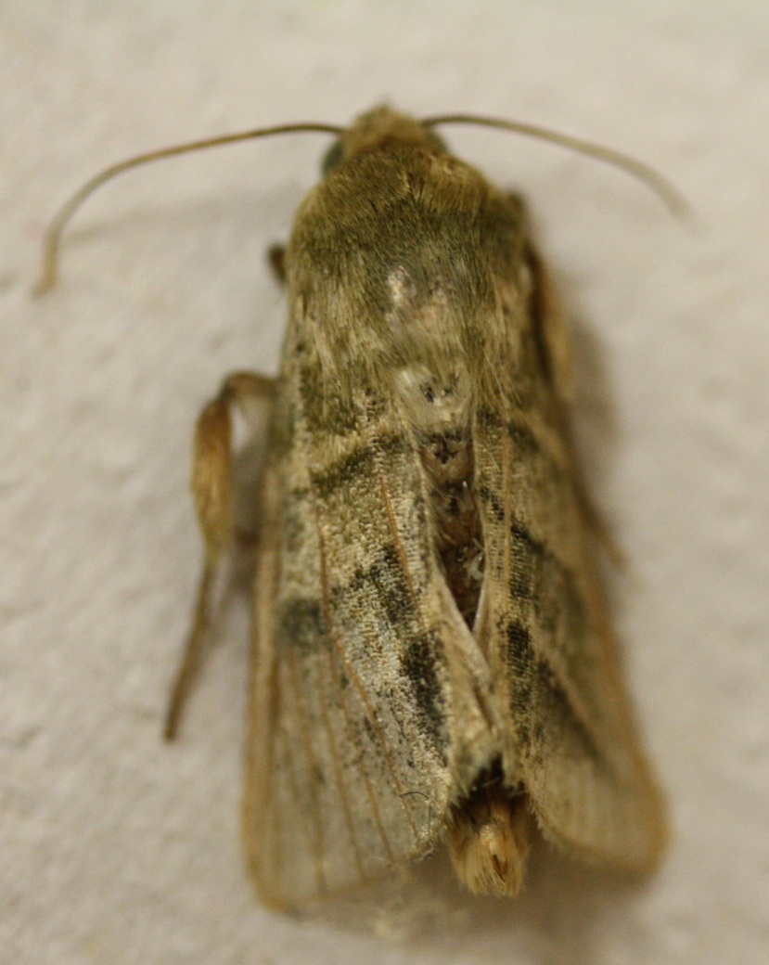
Chloridea virescens

Slide 5

C. virescens are important because they eat so many things

Slide 6
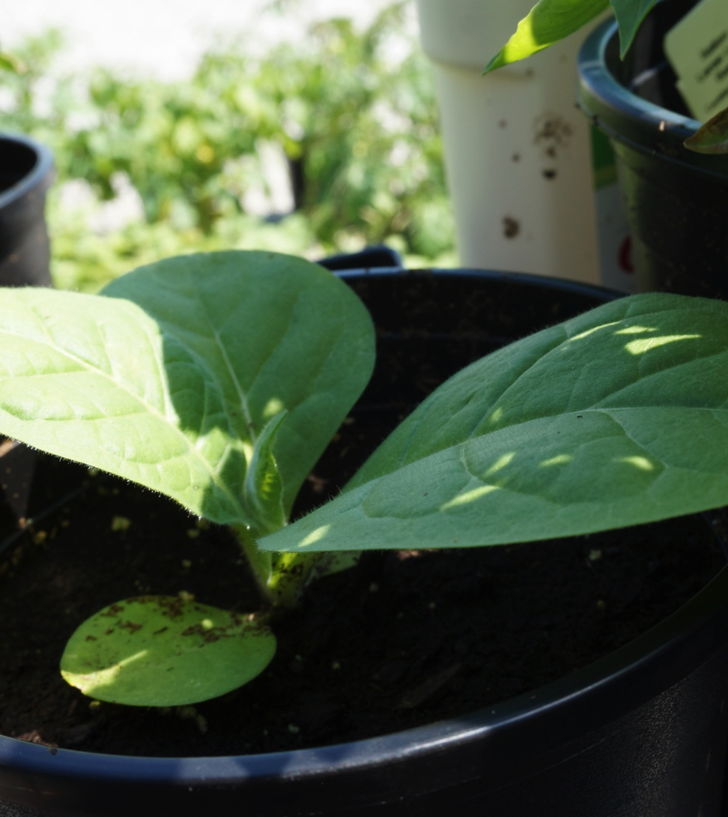
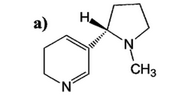
Hosts of C. virescens are well defended.
Tobacco (Nicotiana tabacum): Nicotine
Int. J. Mol. Sci. 2013, 14(5), 10242-10297; doi:10.3390/ijms140510242
Notes:
When ingested in larger doses, nicotine is a highly toxic poison that causes vomiting and nausea, headaches, stomach pains, and, in severe cases, convulsions, paralysis, and death."

Slide 7
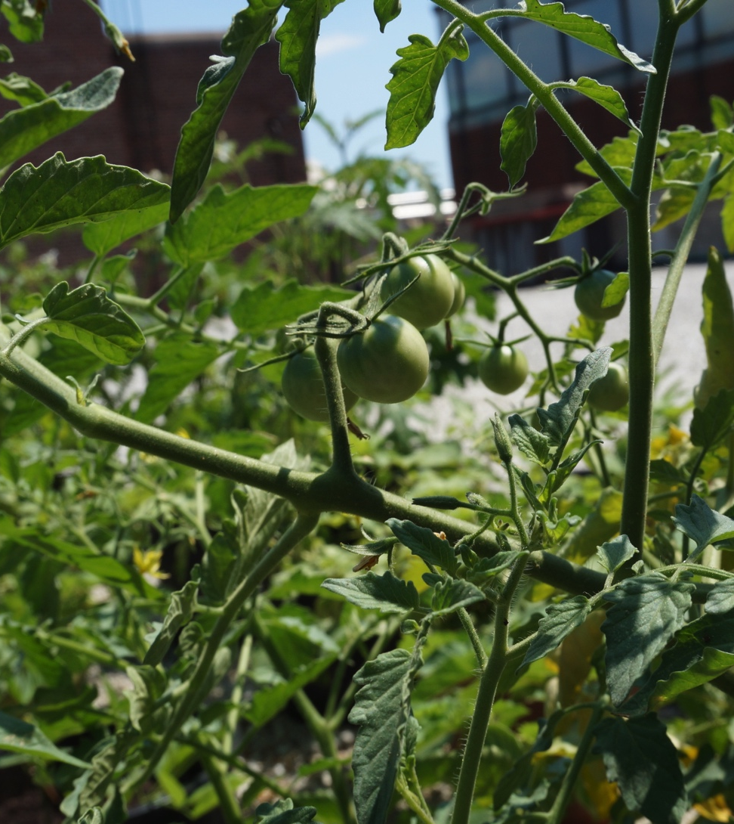
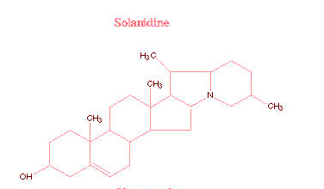
Tomato (Solanum lycopersicon): Glycoalkaloids
Source: Cornell University, College of Agriculture, Web
Notes:
Tomato -Glyco Alkaloids,like solanine which has pesticidal properties

Slide 8
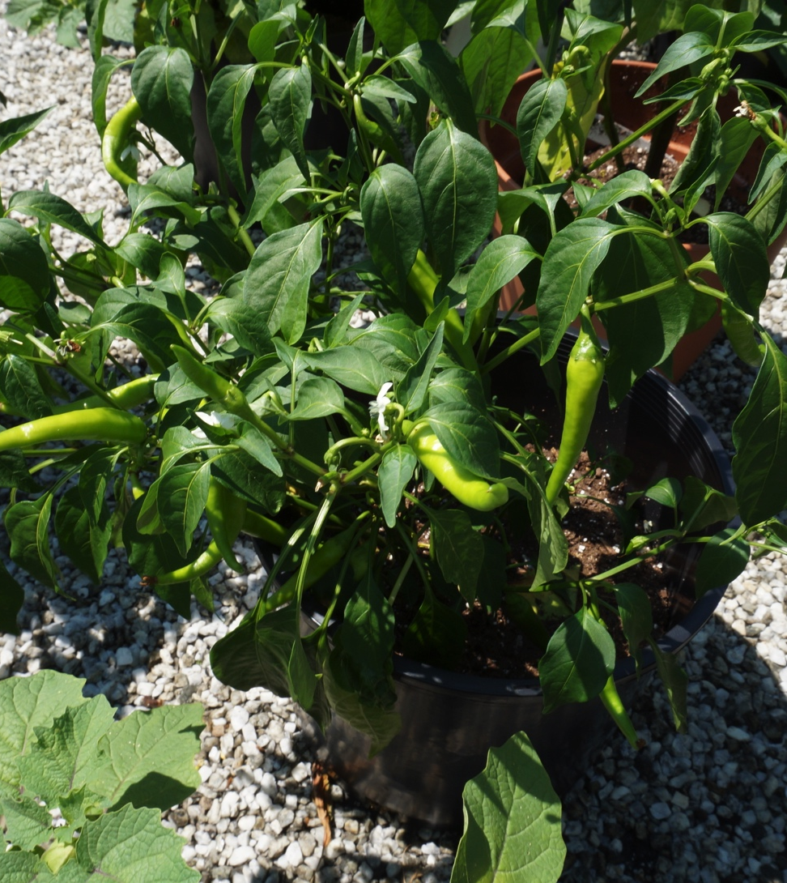
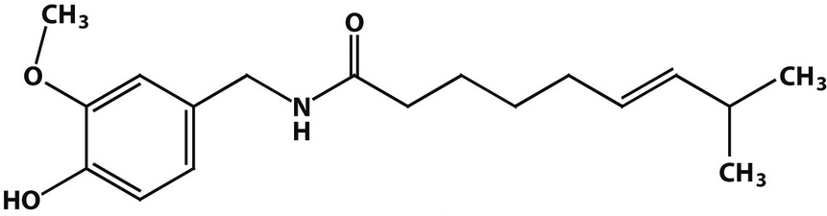
Pepper (Capsicum annuum): Capsaicin
Source: BioChemistry 7th Edition, Freeman and Company, 2012
Notes:
Capsaiscin –Peppers
Capsaicin: "Painful exposures to capsaicin-containing peppers are among the most common plant-related exposures presented to poison centers.^{[citation needed]} They cause burning or stinging pain to the skin and, if ingested in large amounts by adults or small amounts by children, can produce nausea, vomiting, abdominal pain, and burning diarrhea."
"The burning and painful sensations associated with capsaicin result from its chemical interaction with sensory neurons. Capsaicin, as a member of the vanilloid family, binds to a receptor called the vanilloid receptor subtype 1 (TRPV1).^{[34]} First cloned in 1997, TRPV1 is an ion channel-type receptor.^{[35]} TRPV1, which can also be stimulated with heat, protons and physical abrasion, permits cations to pass through the cell membrane when activated. The resulting depolarization of the neuron stimulates it to signal the brain. By binding to the TRPV1 receptor, the capsaicin molecule produces similar sensations to those of excessive heat or abrasive damage, explaining why the spiciness of capsaicin is described as a burning sensation."

Slide 9
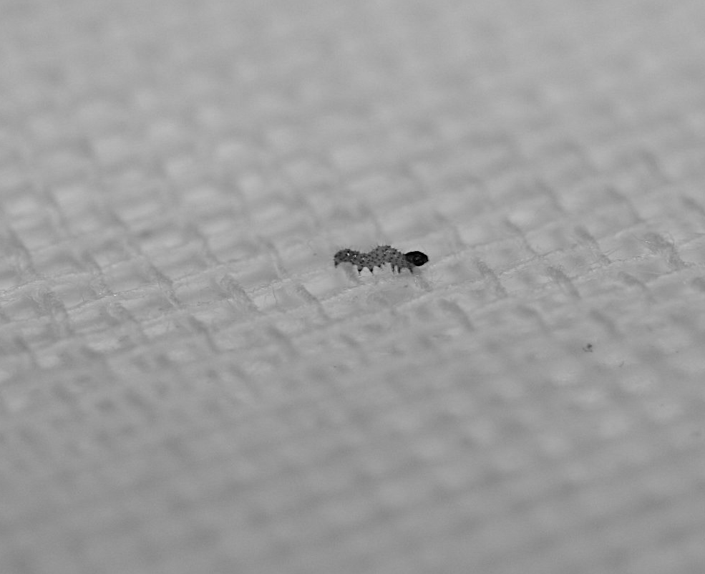
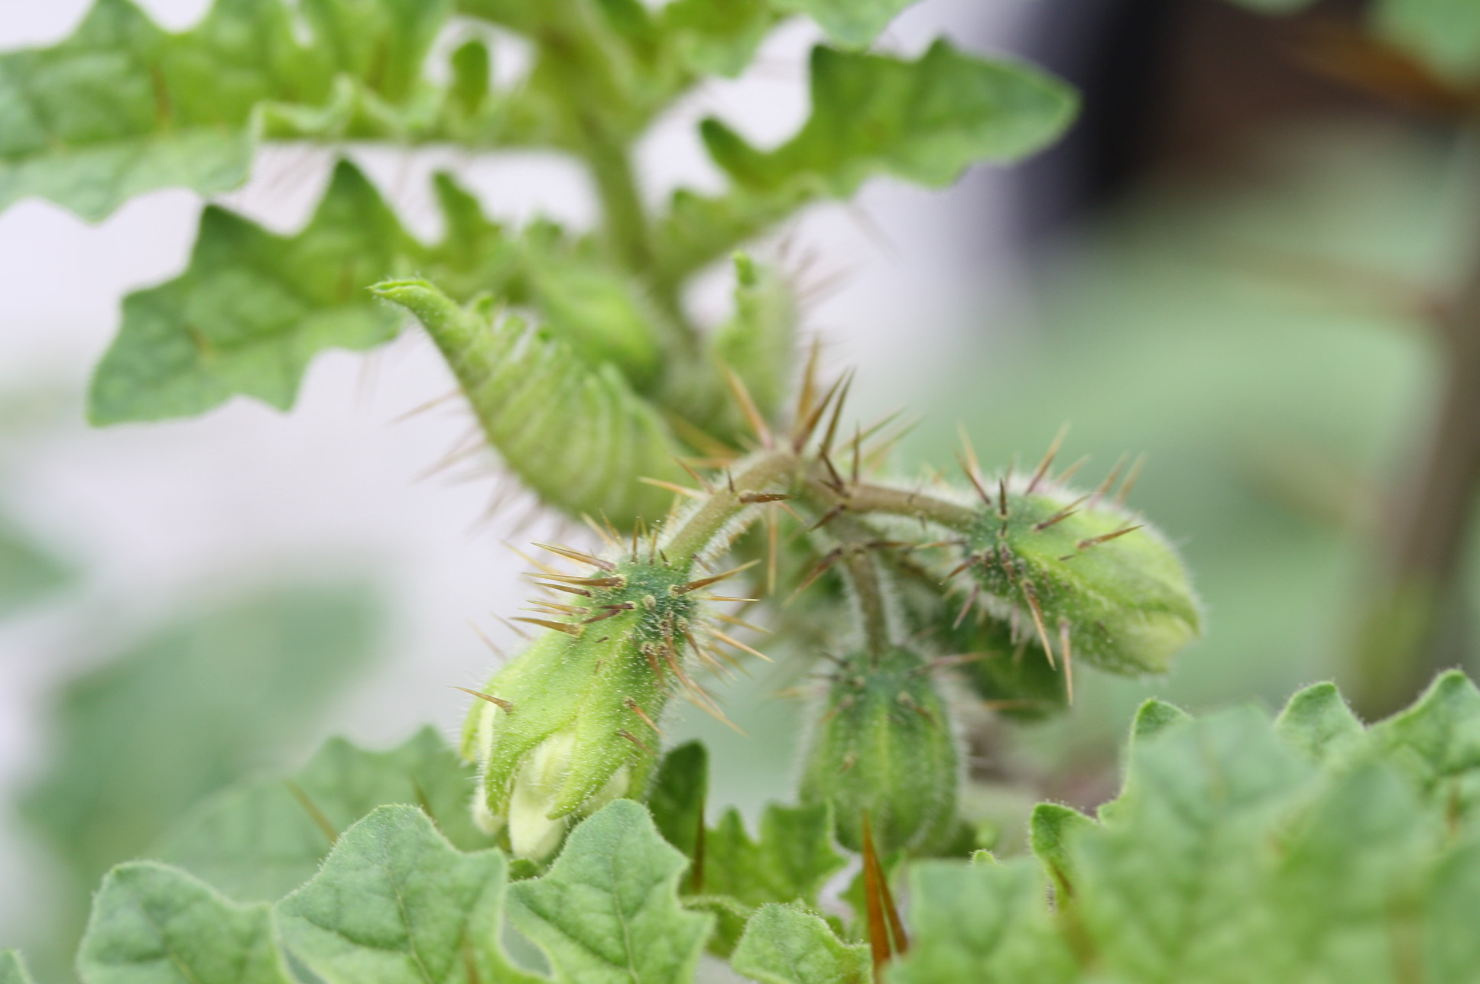
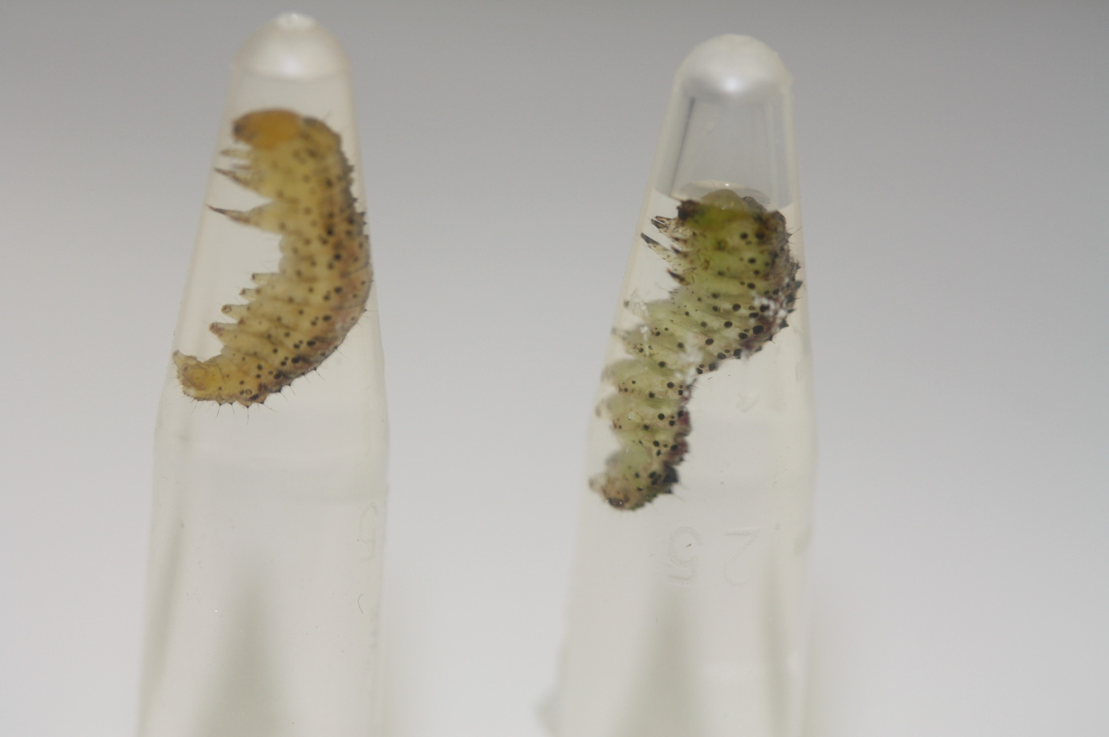
Examining the genetic basis of host plant use
Compare transcriptome profiles of C. virescens reared on different host plants.
2nd instar caterpillars were placed in assay chamber with plant material for 10+ days
Plants used for the assays were grown on the roof of the American Museum of Natural History
Behavior and growth recorded daily
RNA extraction from midgut

Slide 10
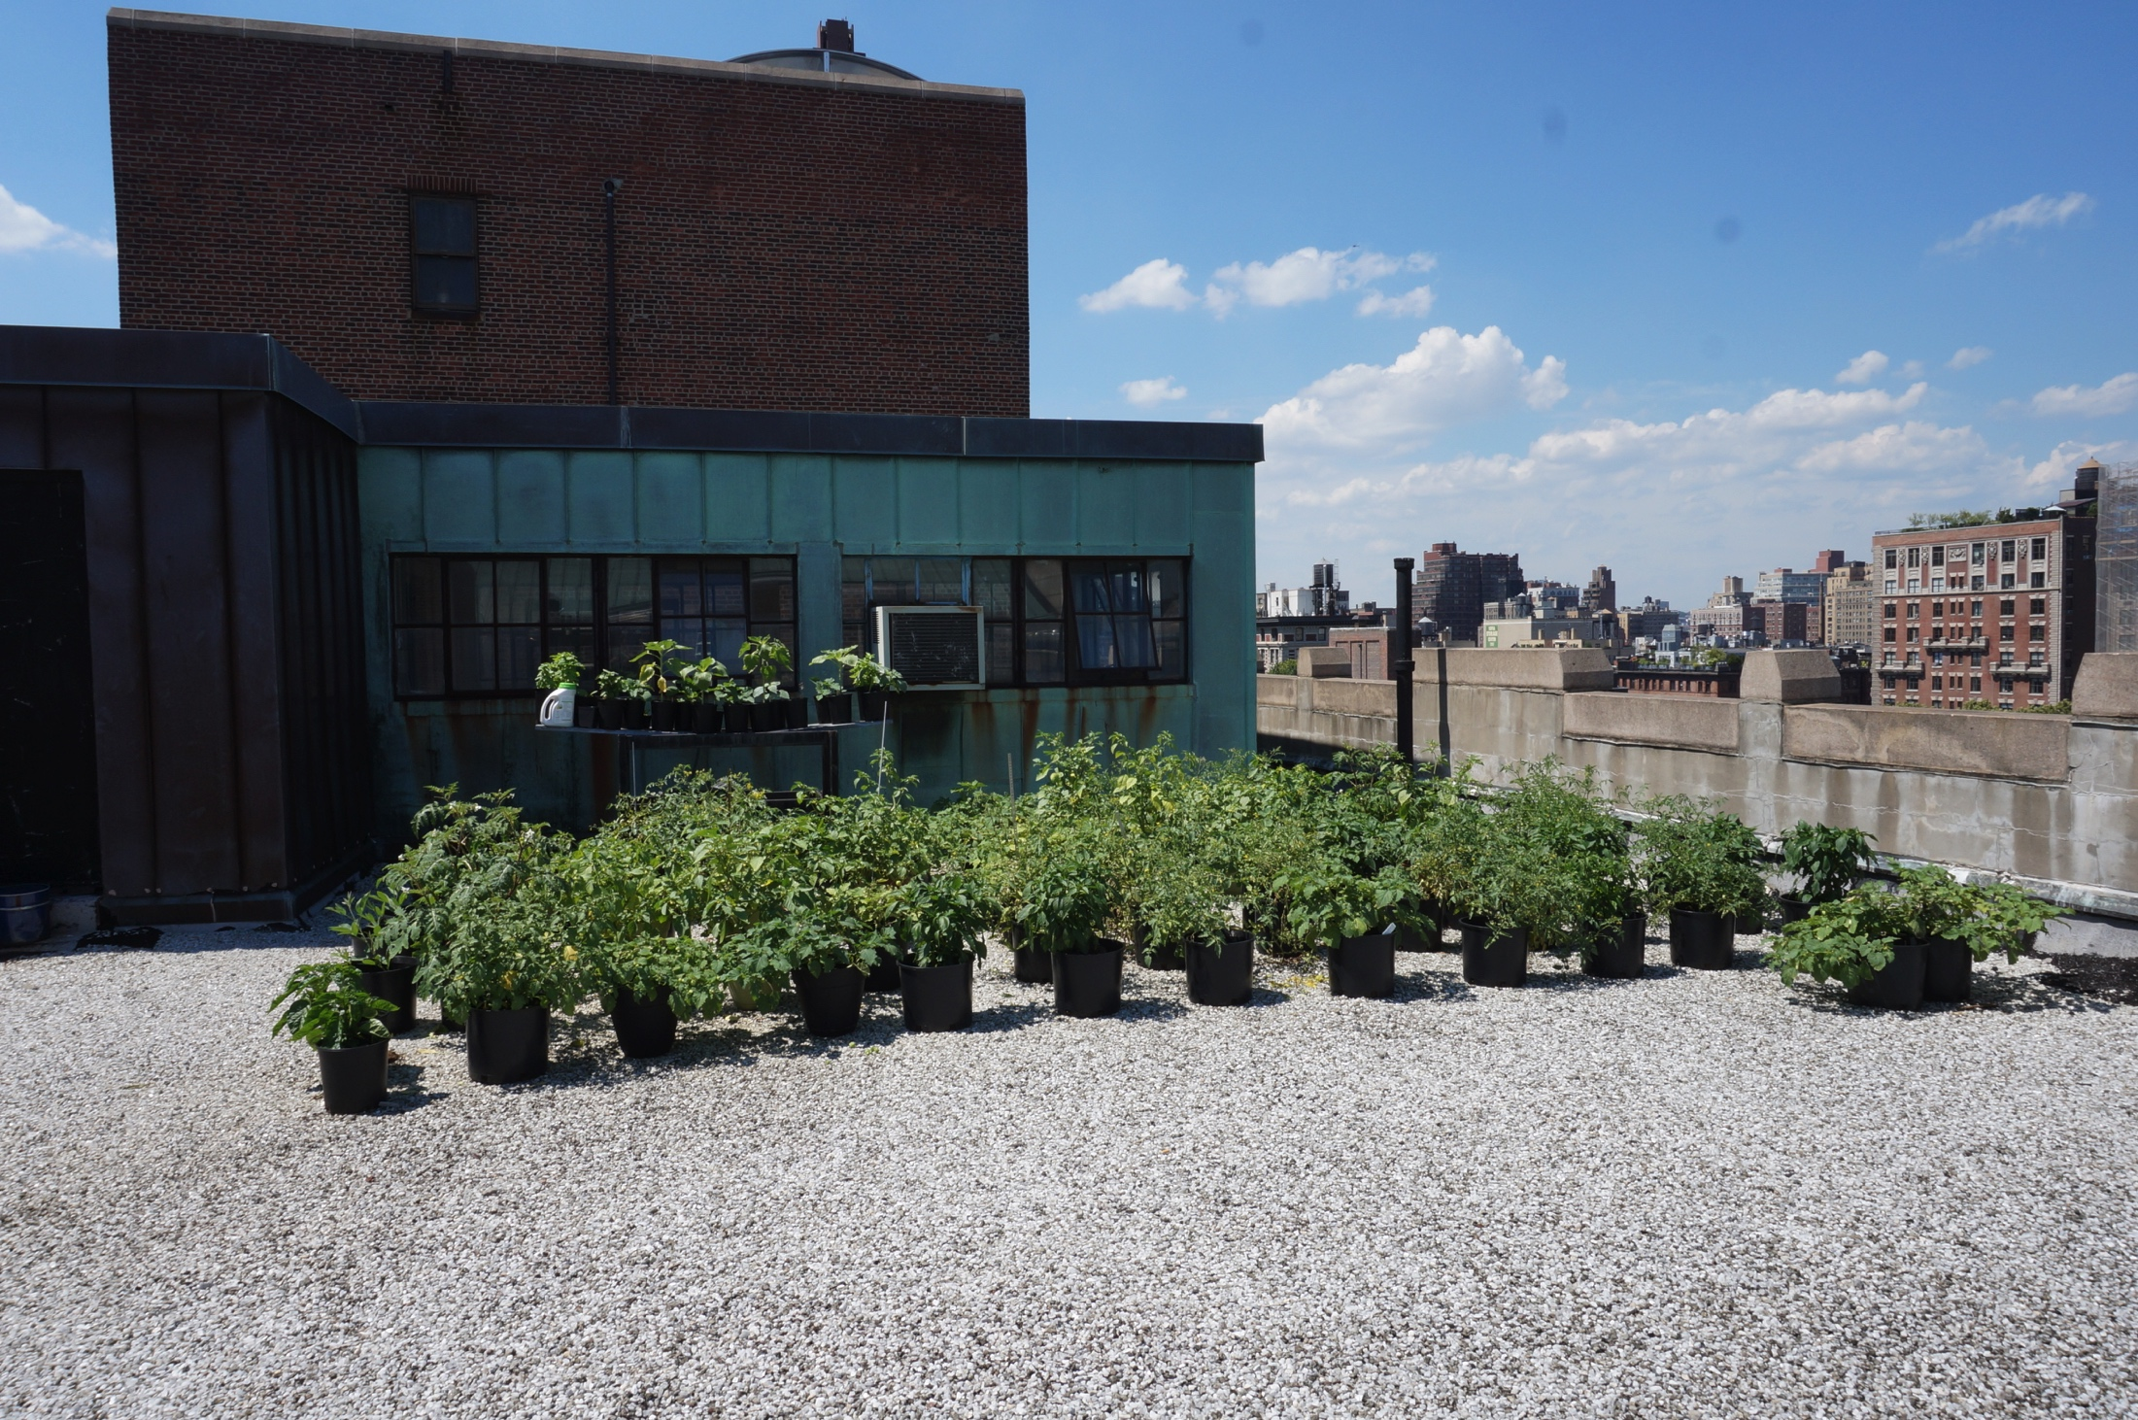
Plants

Slide 11
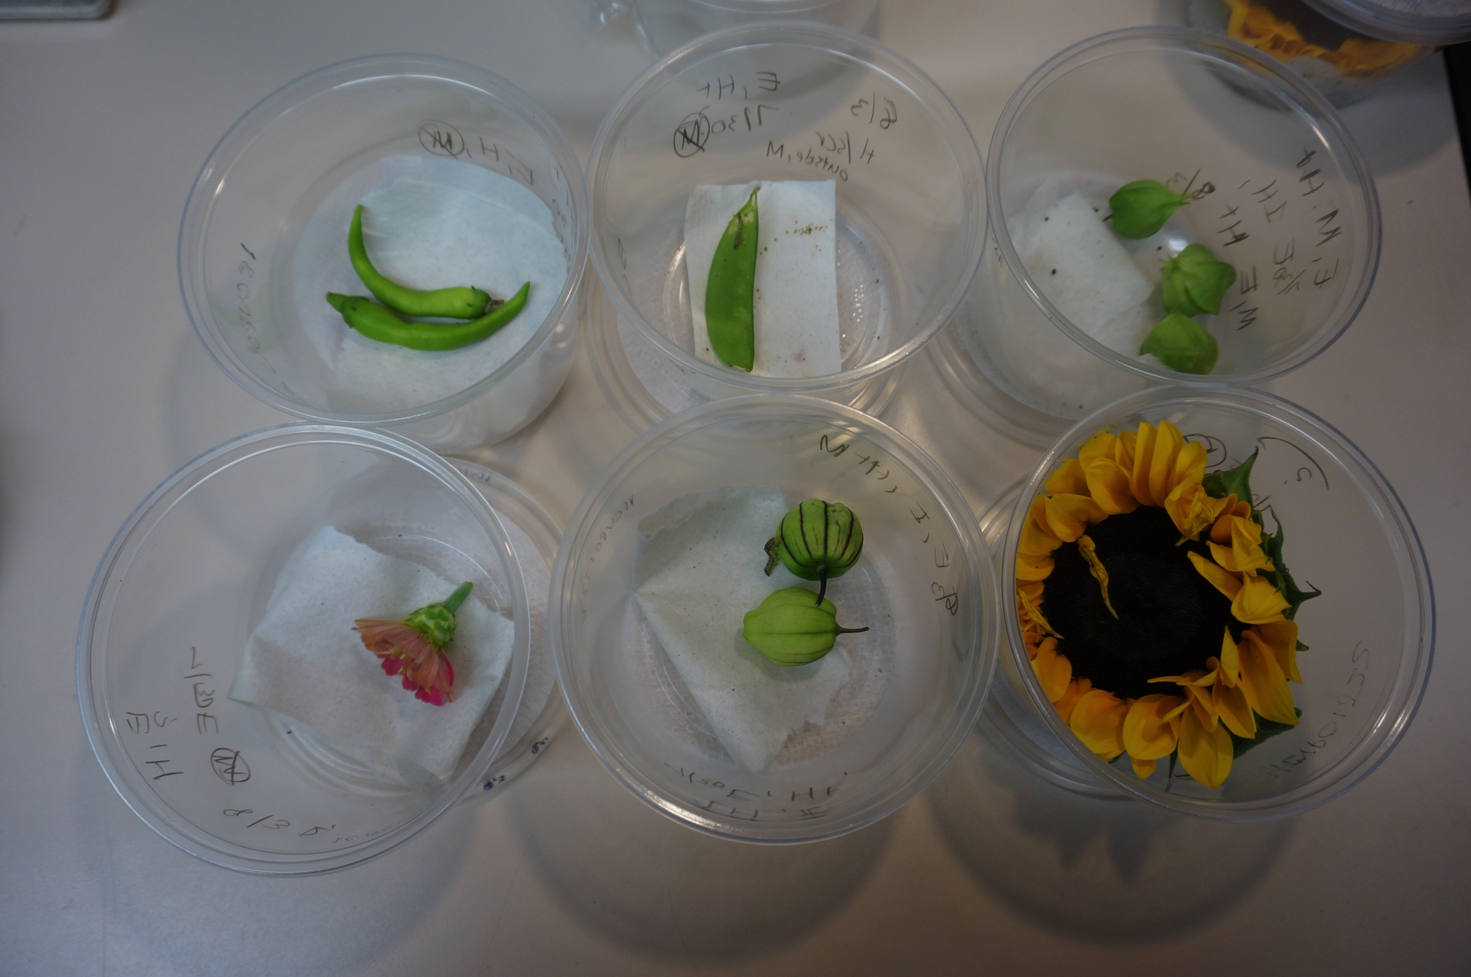
Bioassays

Slide 12
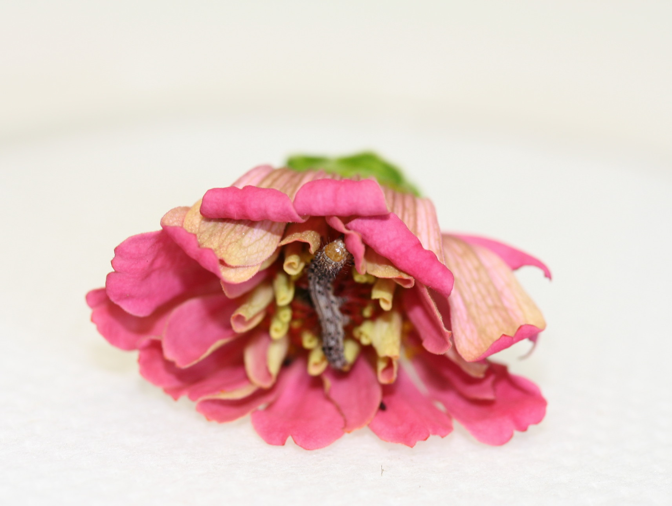
Zinnia (Zinnia elegans)

Slide 13
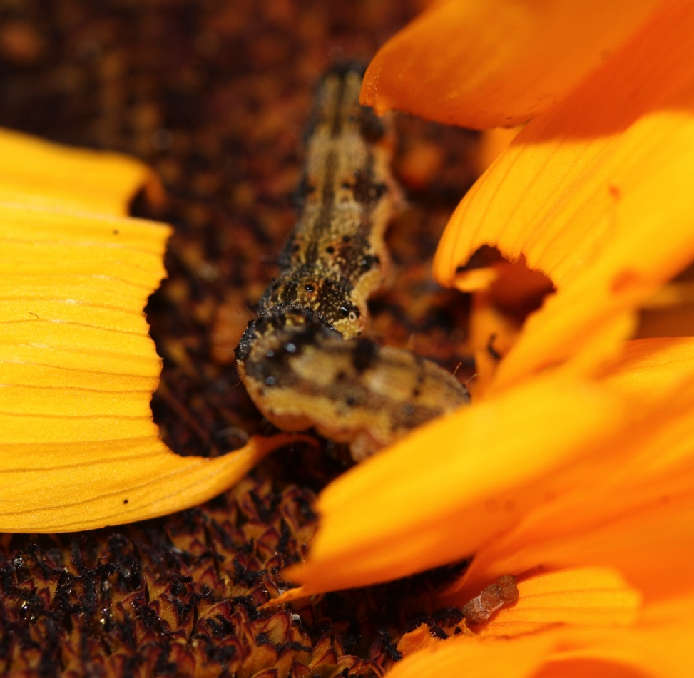
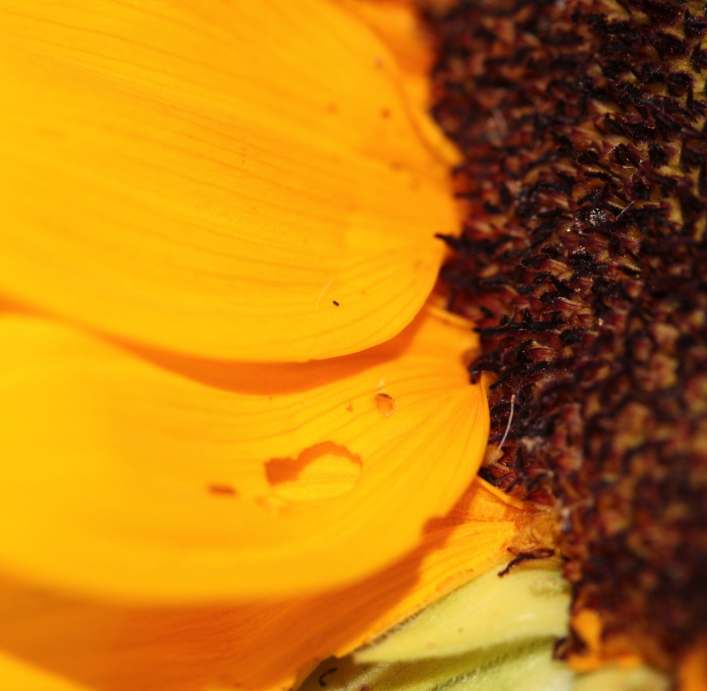
Sunflower (Helianthus annuus)

Slide 14
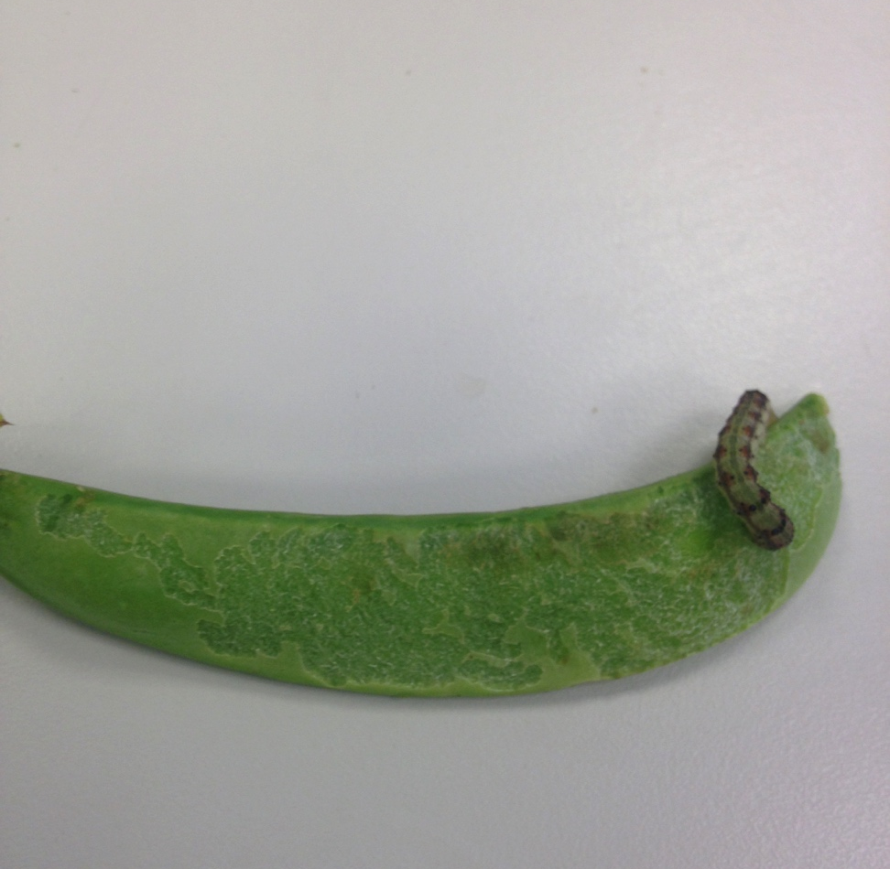
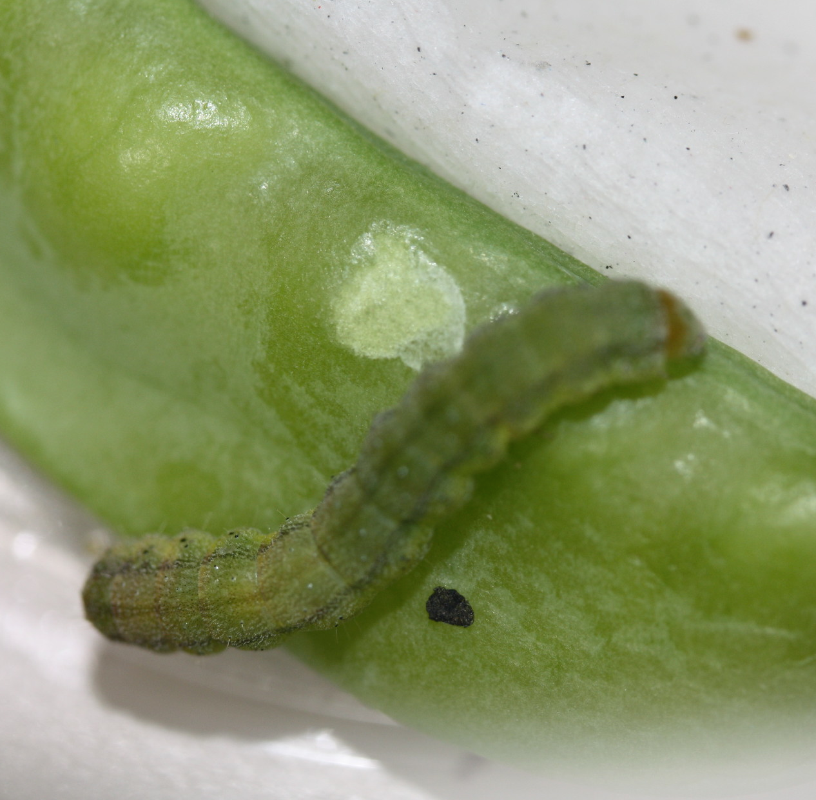
Sugar snap pea (Pisum sativum)

Slide 15
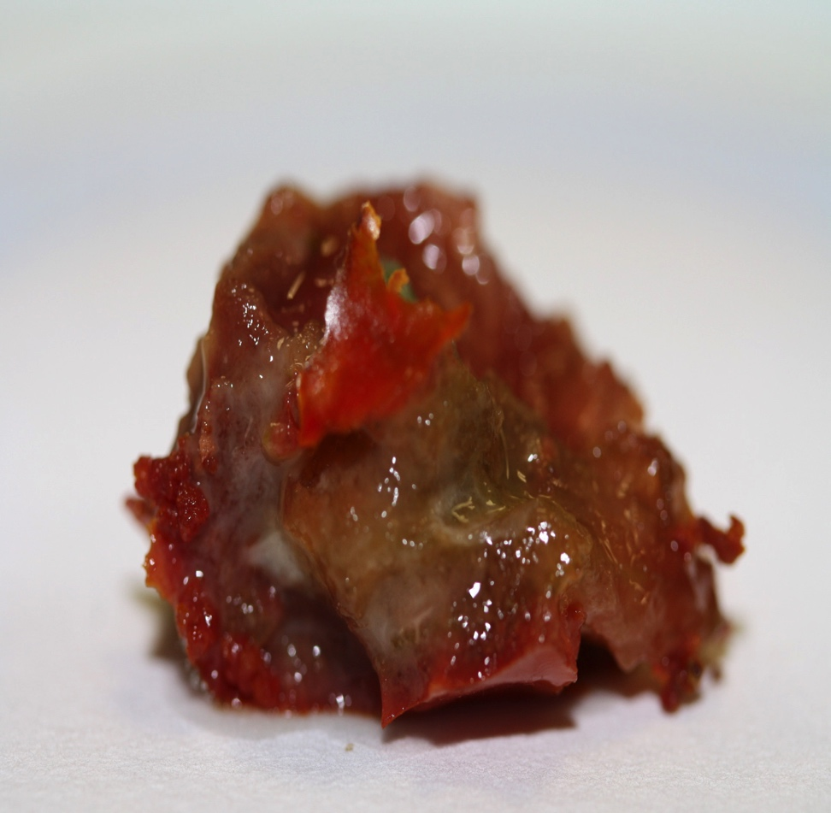
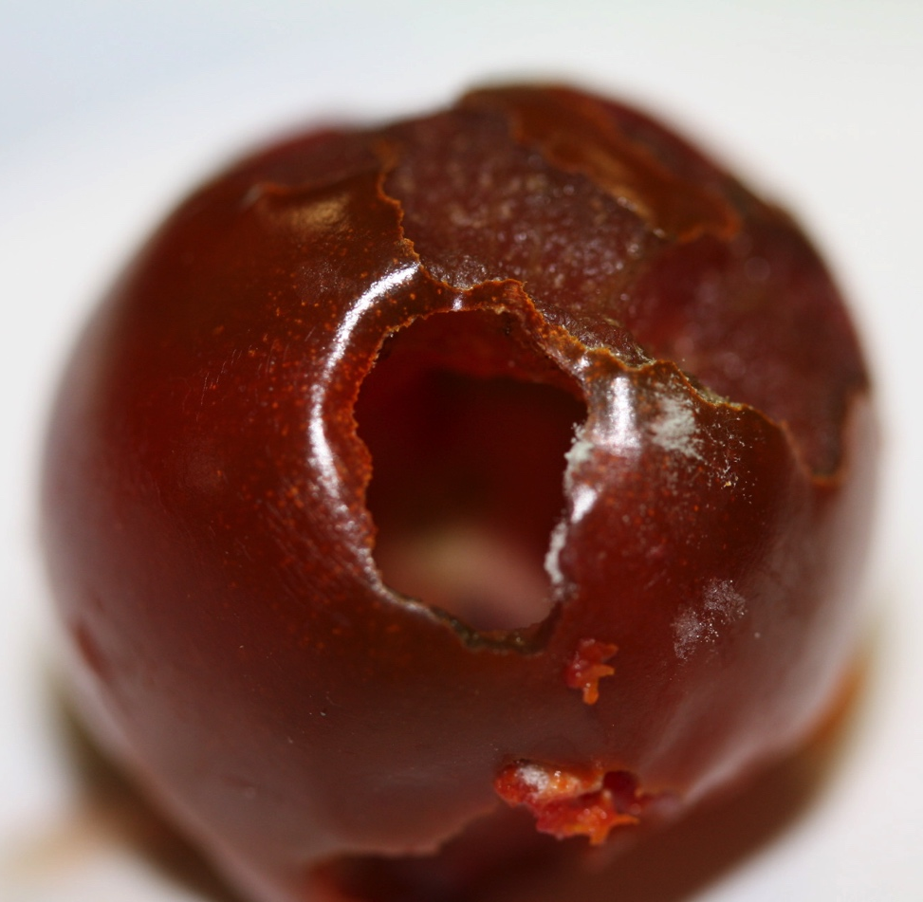
Tomato (Solanum lycopersicon)

Slide 16
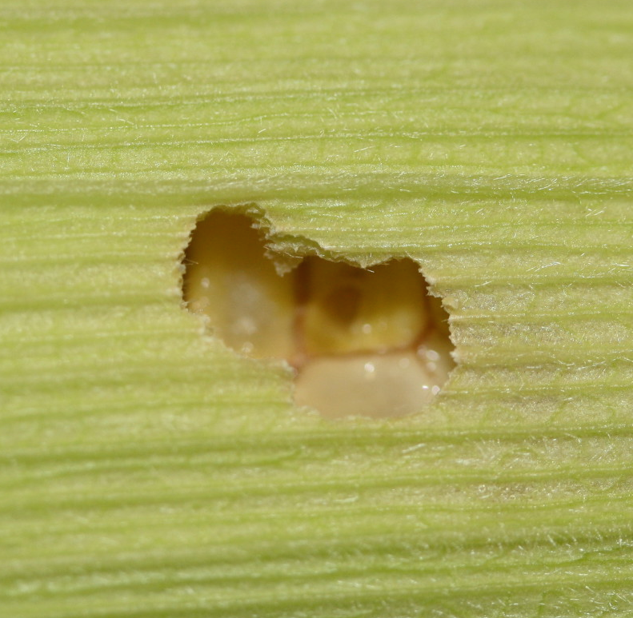
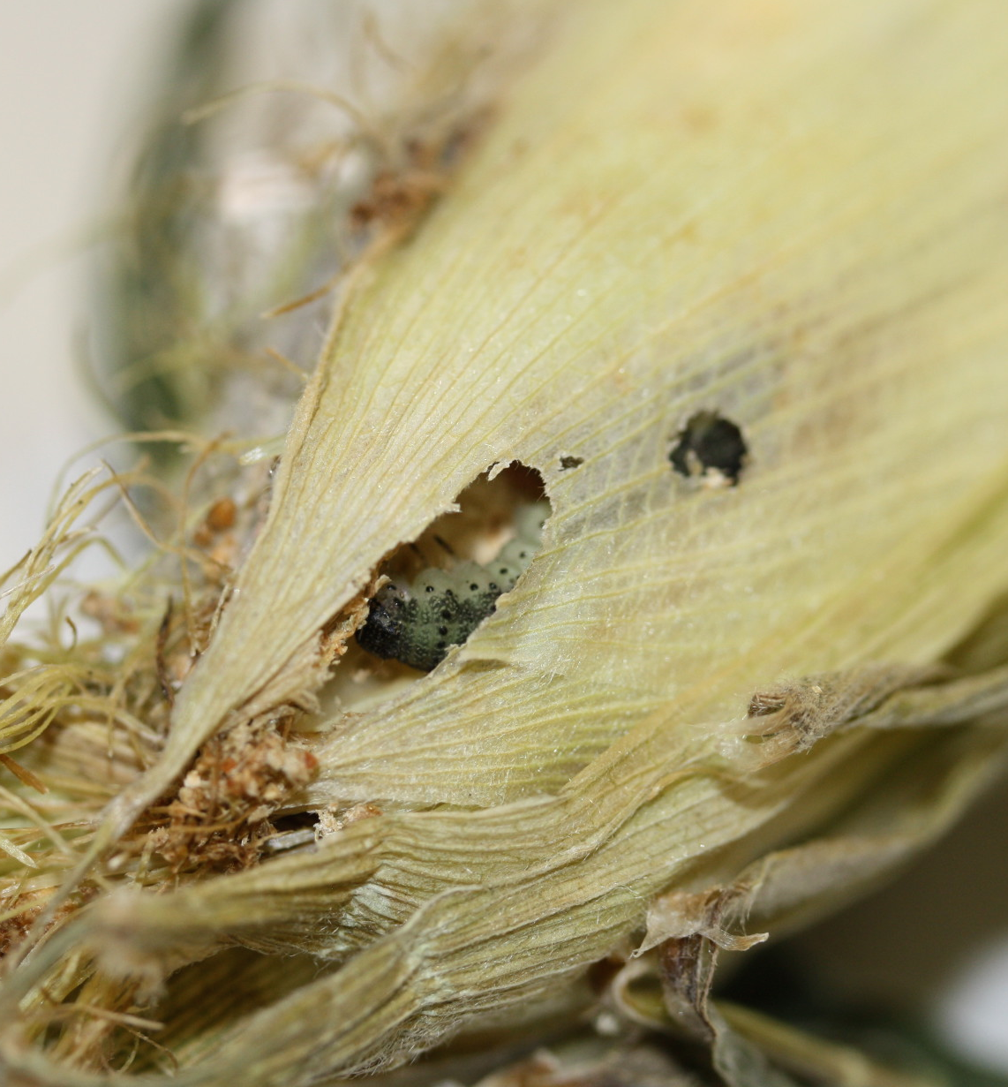
Corn (Zea mays)

Slide 17
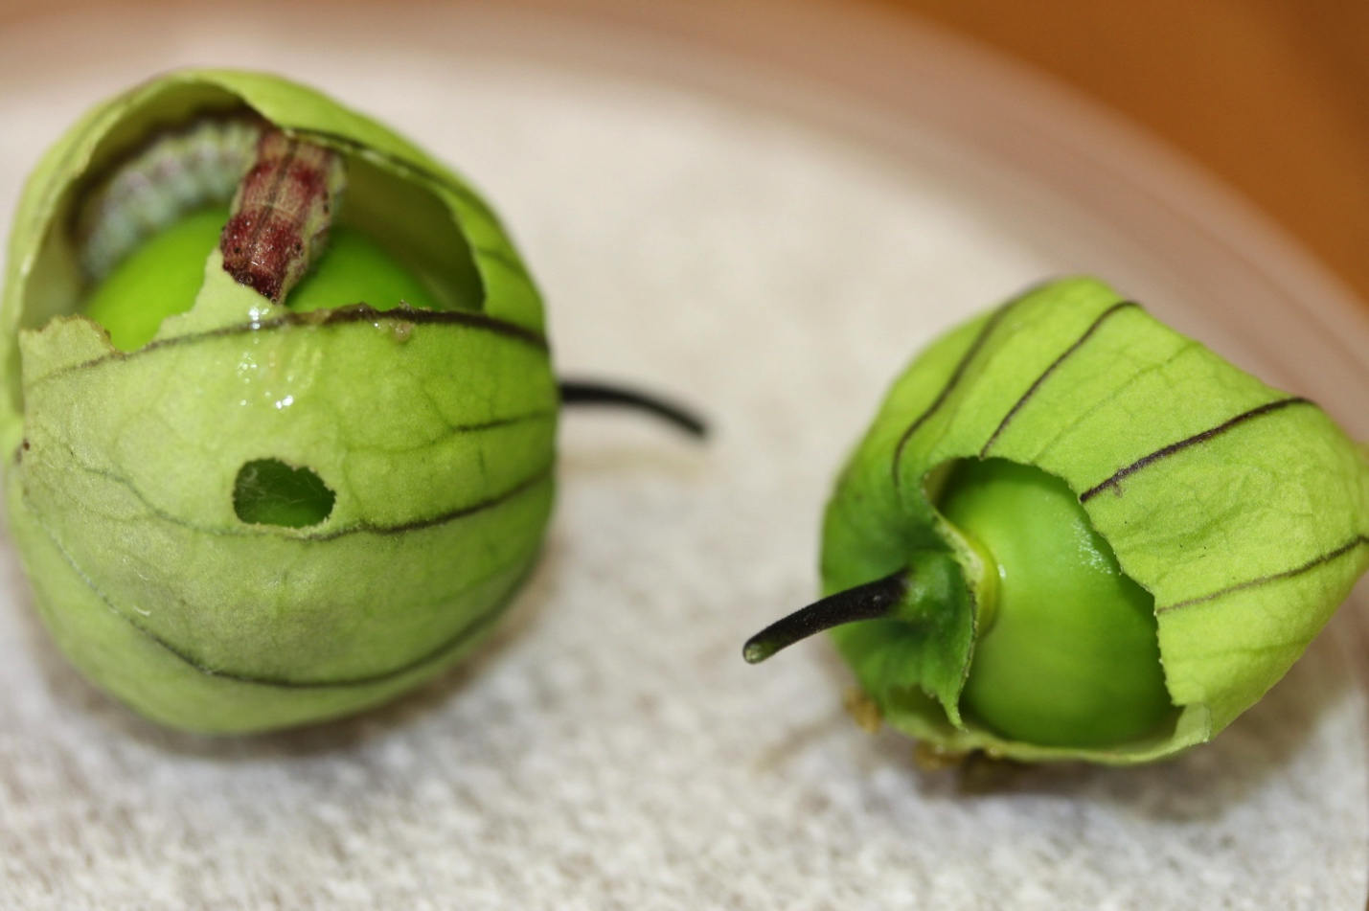
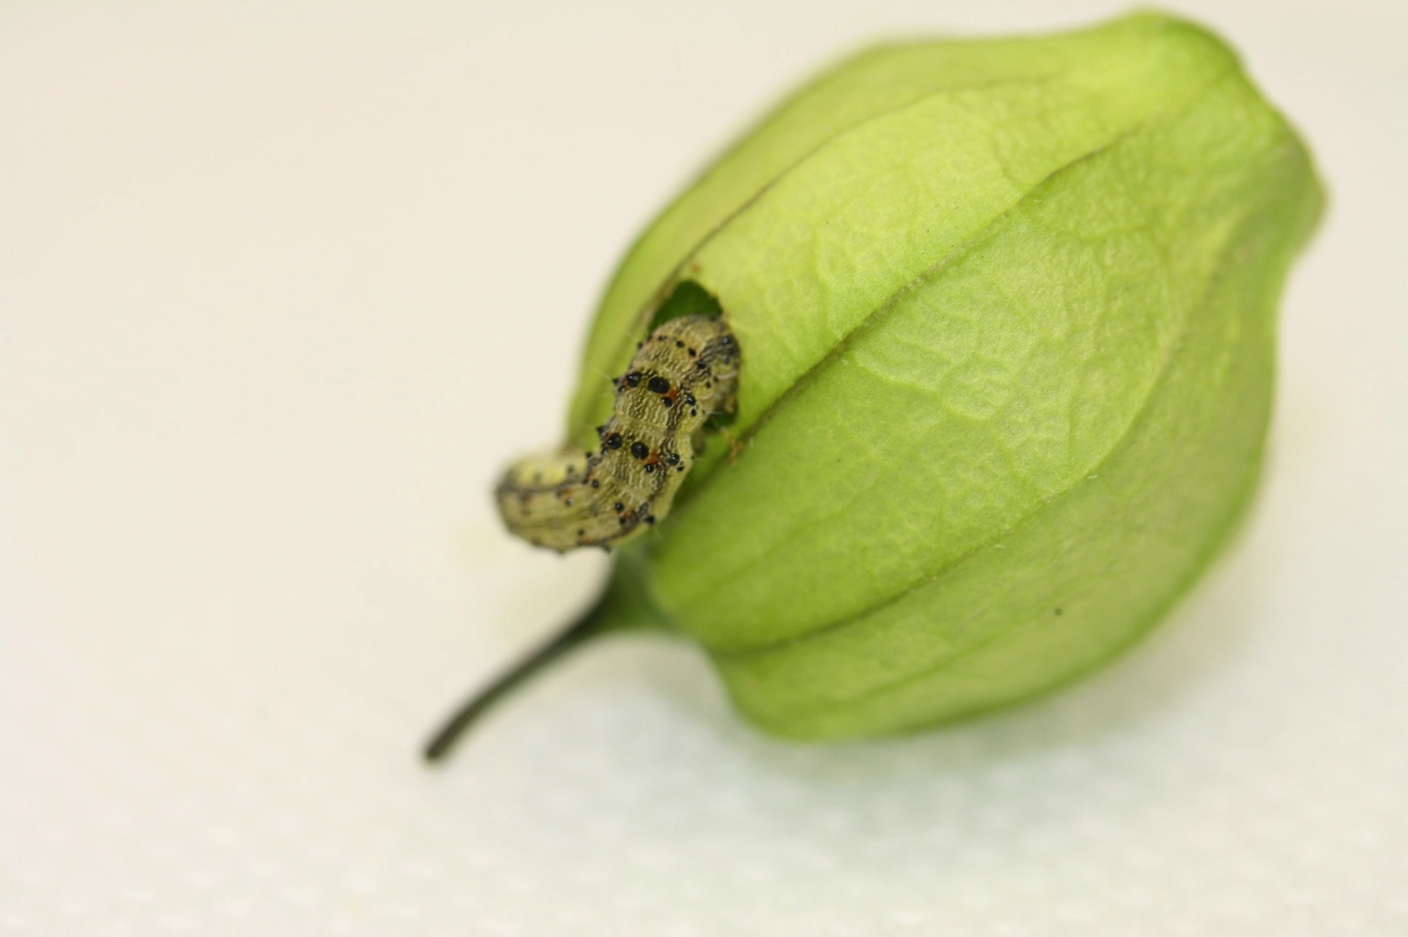
Purple tomatillo ( Physalis ixocarpa)

Slide 18
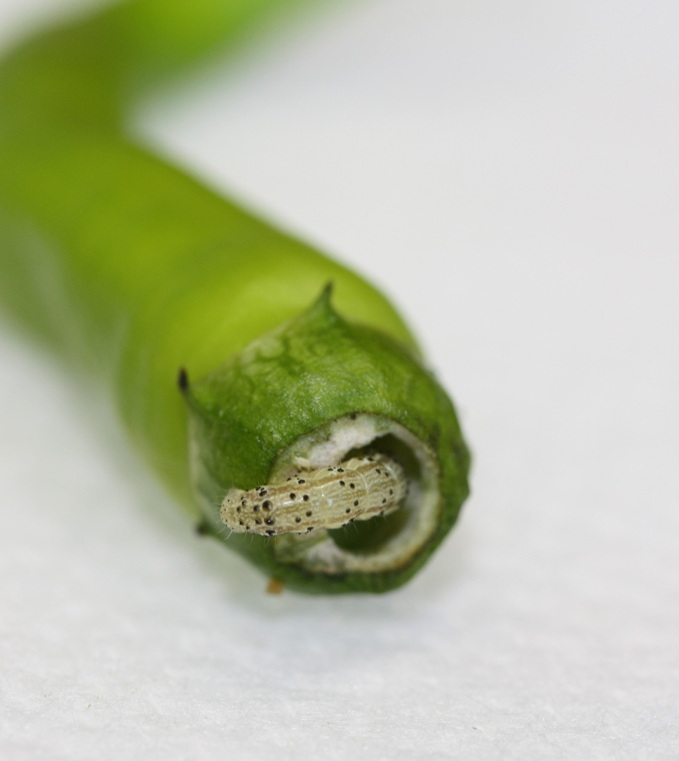
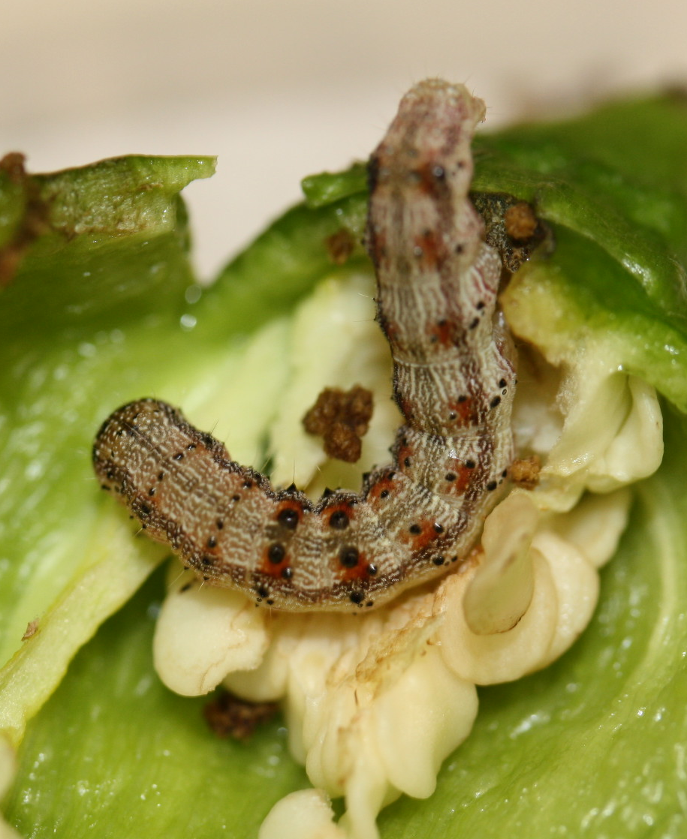
Cayenne pepper (Capsicum annuum)
30,000 – 50,000 Scoville!
5,000- 30,000 Scoville!

Slide 19
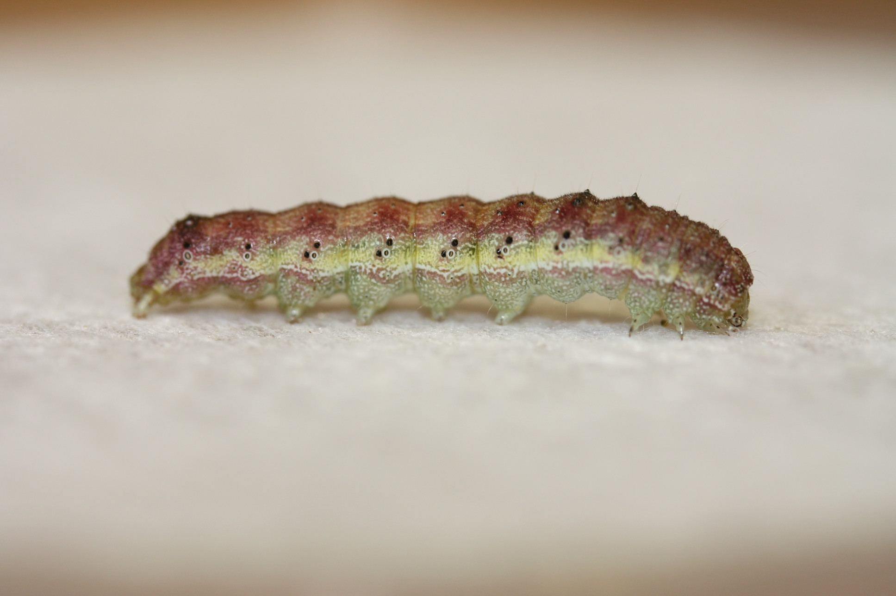
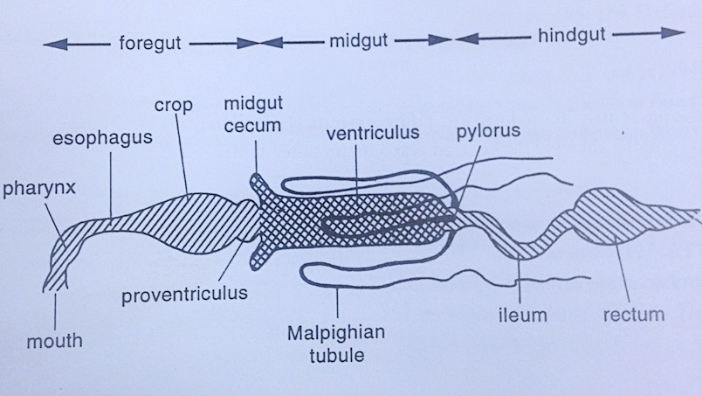
RNA Extraction
Source: Chapman, The Insects Fig. 3.1 major subdivisions in a generalized insect.

Slide 20
Selection for feeding on a novel host (Physalis angulata)
325
Control line (wild type C. virescens)
300
275
Selection line (after 12 generations)
250
225
200
175
150
125
100
75
50
25
0
Percent change
in larval weight
Amount of fruit
Consumed (in mg)
Assimilation
efficiency

Slide 21
Methods
Sequence
Generate a catalog of reads for each phenotype
Illumina, 2x100bp, 100M reads, ~100x coverage
Clean
Eliminate low quality and contaminate reads
Trim galore and Kraken
Assemble
Assemble reads into contigs, identify coding sequences
SOAPdenovo2 and Augustus
Compare
Find genes that differ between phenotypes
BWA-mem and GATK HaplotypeCaller
Annotate
Discover the function of
variant genes
Blast-p, Phyre2, and 3DLigandSite

Slide 22
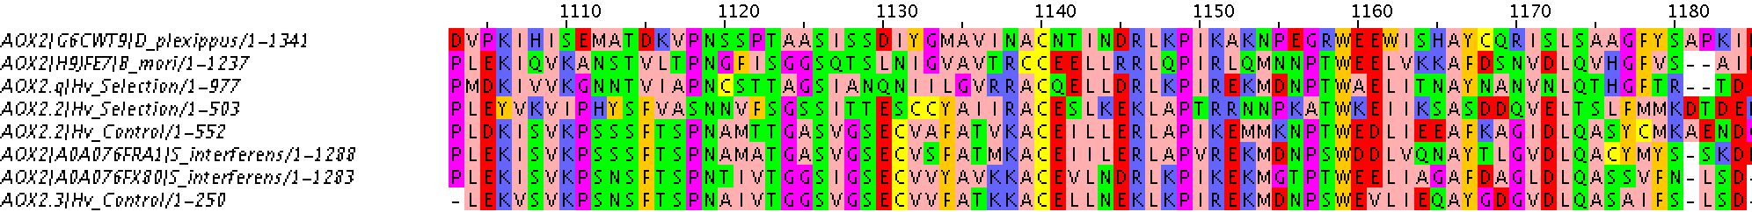
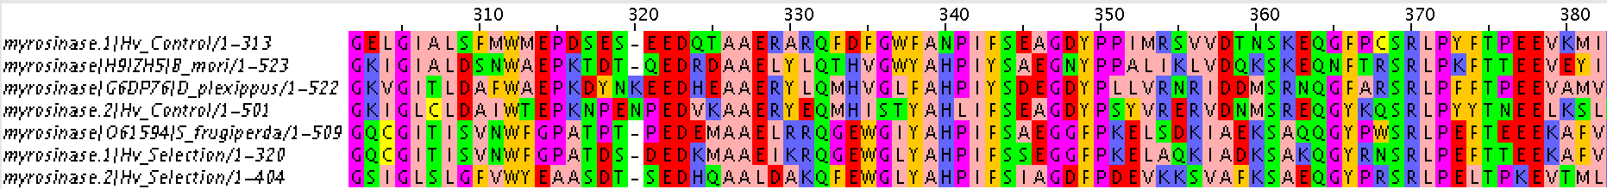
Some identified genes that vary between Selection and Control lines
Aldehyde oxidase 2 (AOX2): Degradation of odorants after signal processing
UDP-glycosyltransferases (UGT): Inactivation and excretion of plant compounds
Myrosinase-like genes: Hydrolysis of plant glucosinolates to form toxic degradation products
Notes:
Genes identified in Selection and Control lines that may be involved in Selection line’s improved performance on Physalis angulata. Shown here aligned to the same gene from other Noctuid moths.

Slide 23
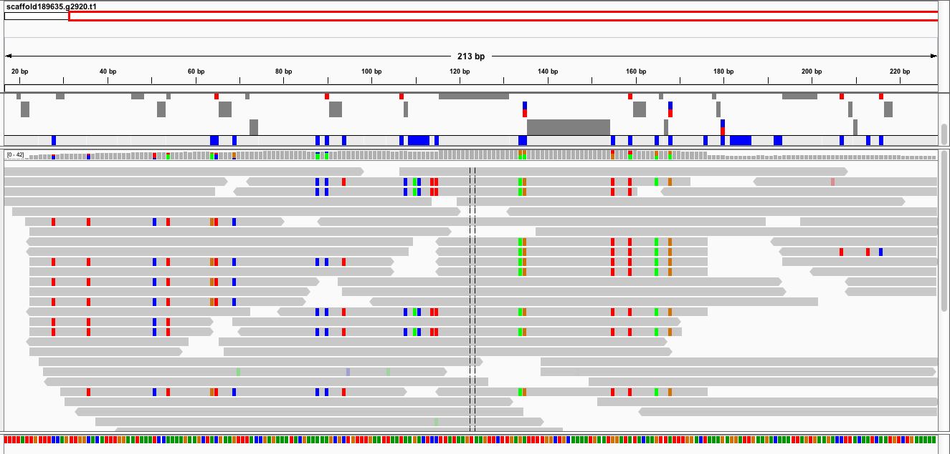
Variation between Selection and Control in a cytochrome P450 gene
Selection line reads aligned to assembled Control line CYP gene

Slide 24
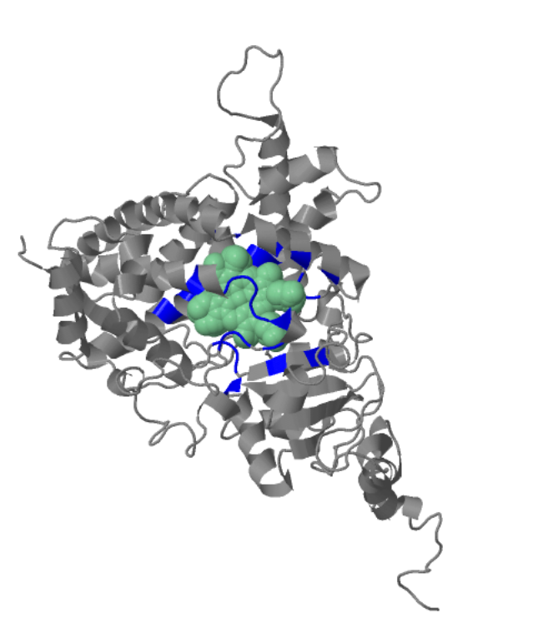
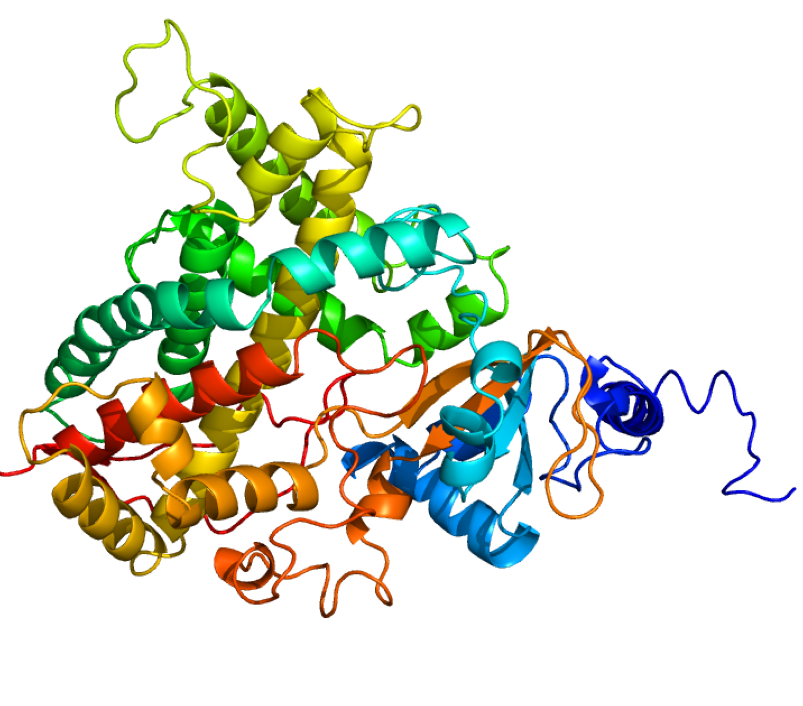
Cytochrome P450 gene function
3D structure
Binding pocket: bound substrate

Slide 25


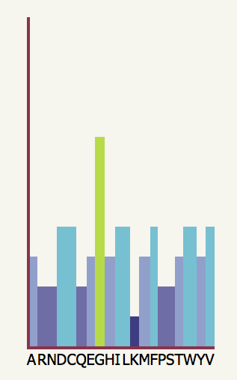

Functional impact of amino acid substitution at variant sites in CYP gene

Slide 26
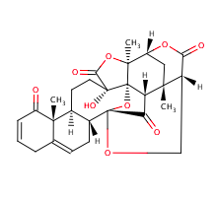
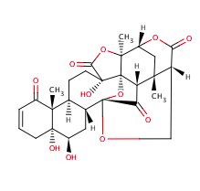
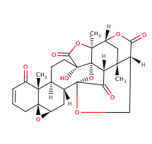
Physalins, the defense compounds of Physalis angulata
Physalin B
Physalin D
Physalin F
Notes:
"The physalins B and F were found to inhibit the growth of several types of human leukaemia cells in vitro and physalin F showed cytotoxicity in vitro on 5 other human cancer cell lines. In addition, physalin F had an antitumour effect in mice in vivo. In vitro withangulatin A was found to be a topoisomerase II inhibitor and a cytotoxin. In tests on rats and mice, vitanolides (isolated from aerial parts) and hyperoside (quercetin-3-O-galactoside; from the leaves) were confirmed to have anti-inflammatory activity. Extracts of Physalis angulata have proven effectiveness against both human African sleeping sickness (Trypanosoma brucei rhodesiense) and Chagas’ disease (Trypanosoma cruzi). They also have an inhibitory effect against several strains of Neisseria gonorrhoeae and molluscicidal properties (Biomphalaria tenagophila)."
Anti malarial,

Slide 27
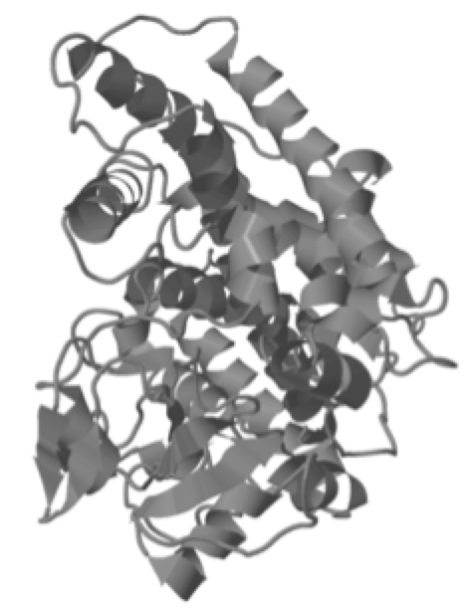
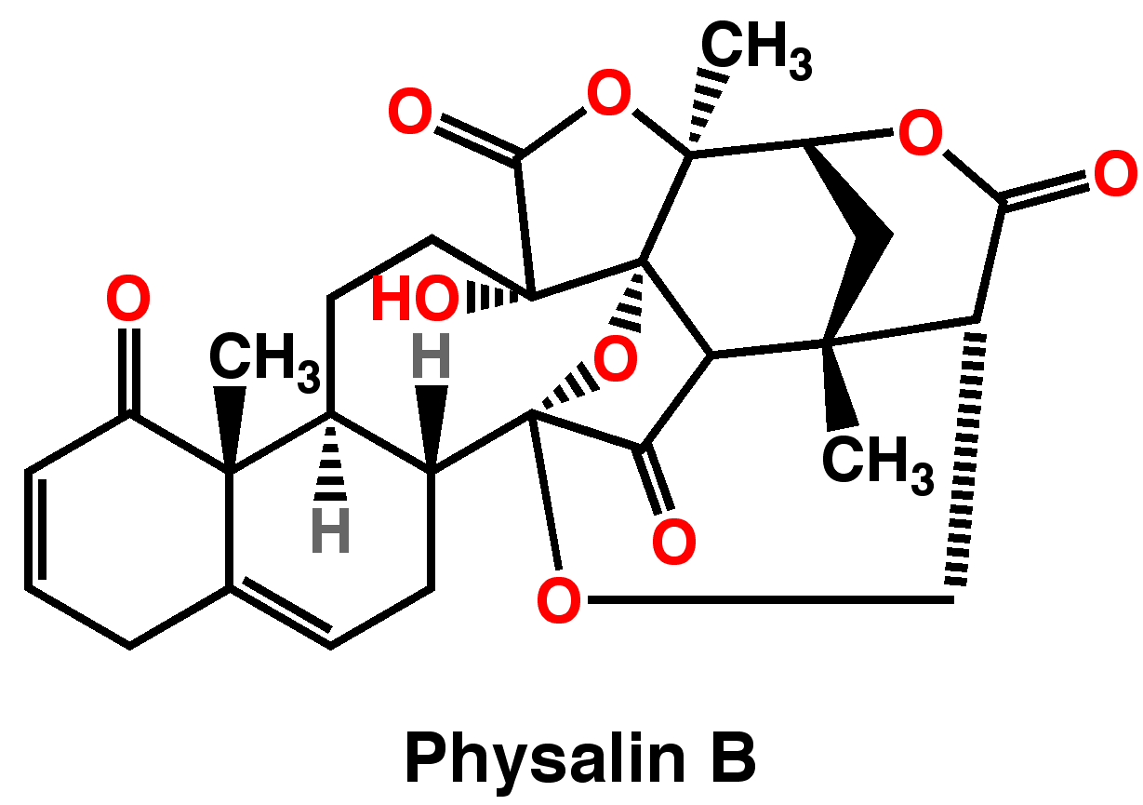

Role of cytochrome P450 in feeding on Physalis angulata…? ? ?
Notes:
Possibly the variant amino acid site we found is involved in dealing with Physalins. If the Selection line has a cytochrome p450 gene that binds Physalins, it may be easier for Selection line to eat and grow on Physalis angulata.

Slide 28
Conclusion and Next Steps
Though I do not know the functional implications of these differences, I am excited to conduct analysis of the cytochrome P450 gene expression once I have the transcriptome data.
More assays will be conducted with pigeon pea, additional Physalis spp., and tobacco.
All assays will be repeated with the specialist, Chloridea subflexa.
This summer I gained skills in bioinformatics and experimental design; learned how plants use chemicals to communicate; and how herbivorous insects select their host plants.

Slide 29
Acknowledgements
Thank you!!!
Dr. Oppenheim and Dr. DeSalle.
Dr. Mark Siddall, Dr. Susan Perkins, Allison Bronson and Maria Rios
NSF
AMNH and RGGS
My fellow REUs
Wiebke Feindt
The Sackler Lab
Dr. Arnold Fleisher

